Slide 1
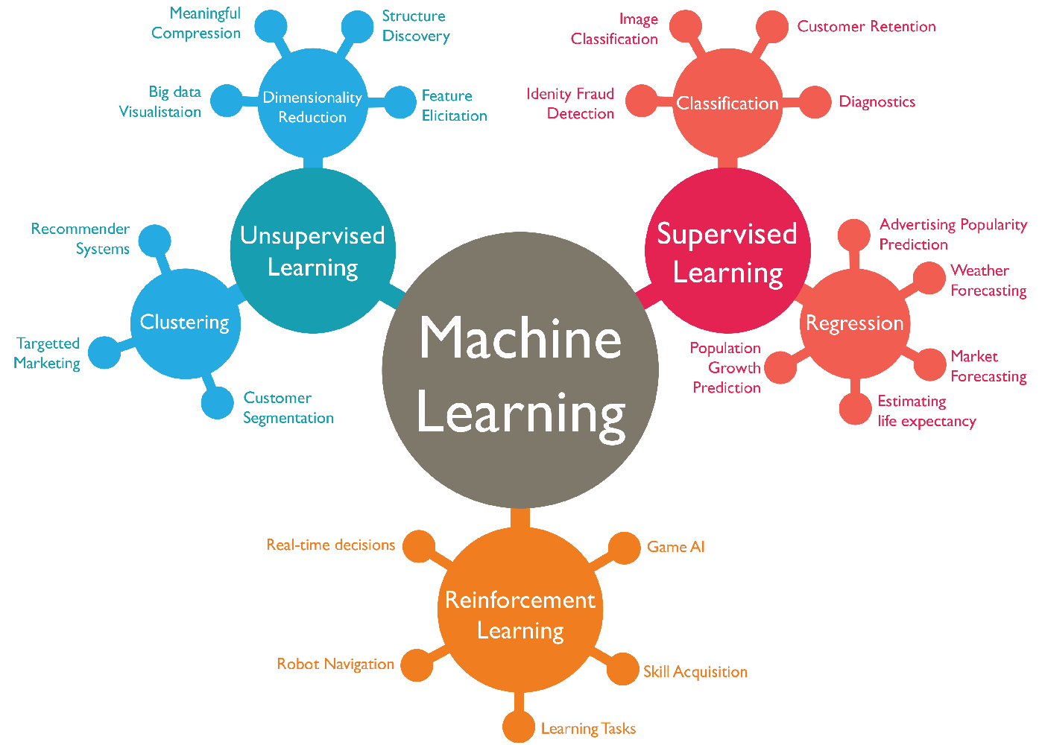

Slide 2

Outline
What Is Machine Learning?
Introducing Scikit-Learn
Supervised learning example
Simple linear regression
Iris classification
Unsupervised learning example
Iris dimensionality
Iris clustering
Hyperparameters and Model Validation
Handout
Cross-Validation
Selecting the Best Model
The bias–variance trade-off
Validation Curves
Learning Curves
Department of Information Technology and Data Science
2

Slide 3
What Is Machine Learning?

Slide 4
What Is Machine Learning?
Machine learning is a method of data analysis that automates analytical model building.
It is a branch of artificial intelligence based on the idea that systems can learn from data, identify patterns and make decisions with minimal human intervention.
Notes:
การเรียนรู้เครื่อง Machine Learning (ML) : การสอนให้ระบบคอมพิวเตอร์ทำการเรียนรู้ได้ด้วยตนเองโดยการใช้ 'ข้อมูล’
การเรียนรู้ของเครื่องเป็นวิธีการวิเคราะห์ข้อมูลที่สร้างแบบจำลองการวิเคราะห์อัตโนมัติ โดยมีการปรับจูนค่าพารามิเตอร์ต่างๆ ให้เหมาะสมกับข้อมูล
เป็นสาขาของปัญญาประดิษฐ์ตามแนวคิดที่ว่าระบบสามารถเรียนรู้จากข้อมูลระบุรูปแบบและตัดสินใจด้วยการแทรกแซงของมนุษย์น้อยที่สุด
เป็นสิ่งที่ทักษะการคำนวณและอัลกอริทึมตอบสนองการคิดเชิงสถิติของวิทยาศาสตร์ข้อมูล
ผลลัพธ์คือชุดของวิธีการอนุมานและการสำรวจข้อมูลจากการคำนวณที่มีประสิทธิภาพ

Slide 5



What Is Machine Learning?
Train
Test
Data
Machine Learning
algorithm
Patterns
Prediction
Answer
Future
Data
Model
Patterns
Credit: KBTG x MeowCode

Slide 6
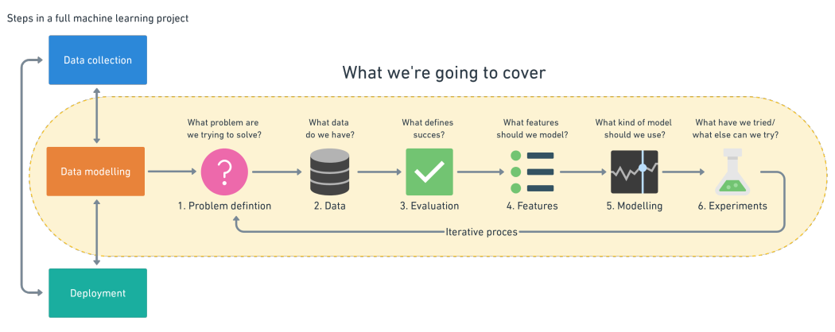
Steps in a full ML project

Slide 7
Goals of this Session
To introduce the fundamental vocabulary and concepts of machine learning.
To introduce the Scikit-Learn API and show some examples of its use
Department of Information Technology and Data Science

Slide 8
Categories of Machine Learning
https://medium.com/mmp-li/เริ่มเรียน--machine-learning-0-100-introduction-1c58e516bfcd

Slide 9
Our Focus
Supervised learning
Unsupervised learning

Slide 10
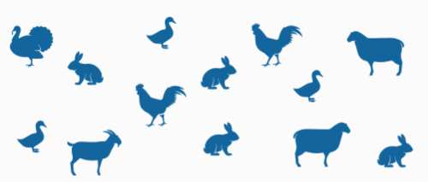

How could we categorise these animals?

Slide 11
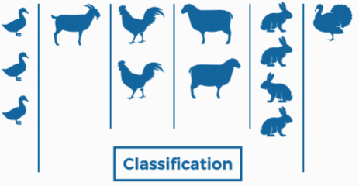
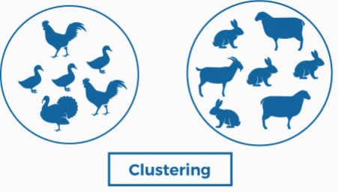
How could we categorise these animals?

Slide 12
Supervised learning
Learning is guided by an instructor. The data set is labelled.
Supervised learning involves somehow modelling the relationship between measured features of data and some label associated with the data.
Subdivided into
Classification
the labels are discrete categories
Regression
the labels are continuous quantities.
Classification
Regression
Notes:
ชนิดของข้อมูล
structured เก็บอยู่ในรูปแบบของตาราง
unstructured ไม่สามารถเก็บอยู่ในรูปแบบของตารางได้ เช่น ภาพ เสียง ข้อความ
Regression
ทำนายราคาหุ้น เป็นข้อมูลตามช่วงเวลาในอดีต ข้อมูล label และเป็นตัวเลข
ขายราคาบ้านเท่าไร
มีกี่คนจะซื้อ app ที่เราพัฒนา

Slide 13
Unsupervised learning
The model learns through perception and discovers structures in the information. The data set is not labelled.
“letting the dataset speak for itself.”
Subdivided into
Clustering
identify distinct groups of data
Dimensionality reduction
search for more succinct representations of the data.
Clustering
Dimensionality reduction
Notes:
Dimensionality reduction : ค้นหา การนำเสนอข้อมูลที่กระชับยิ่งขึ้น

Slide 14
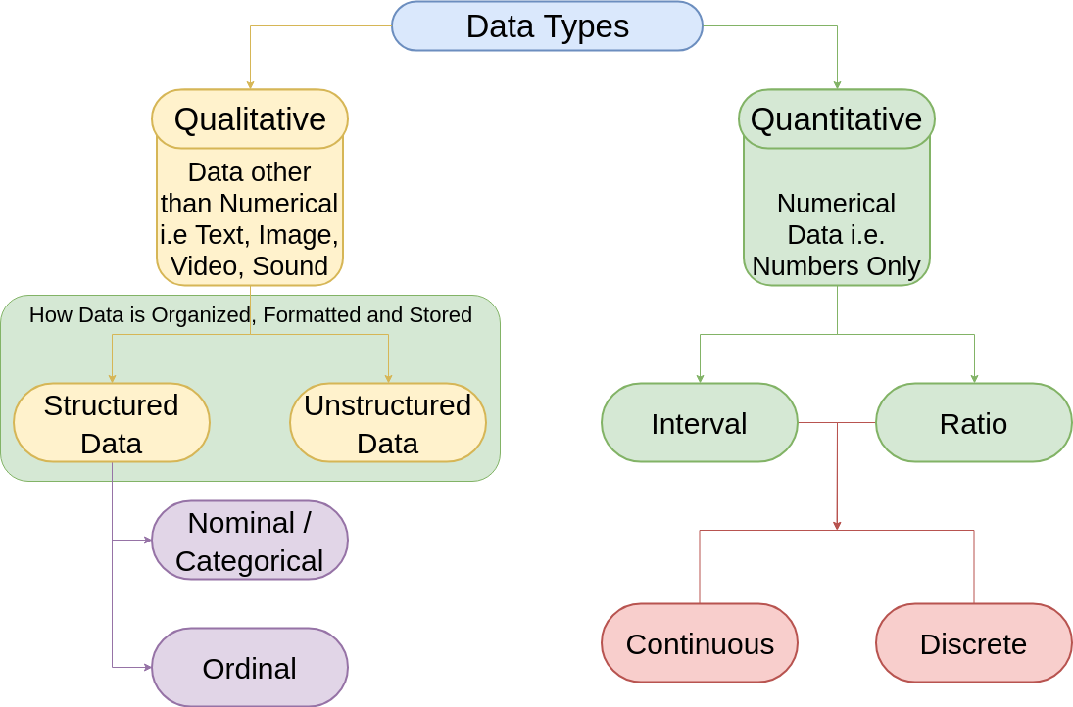
Machine Learning Data Types

Slide 15
Classification

Slide 16
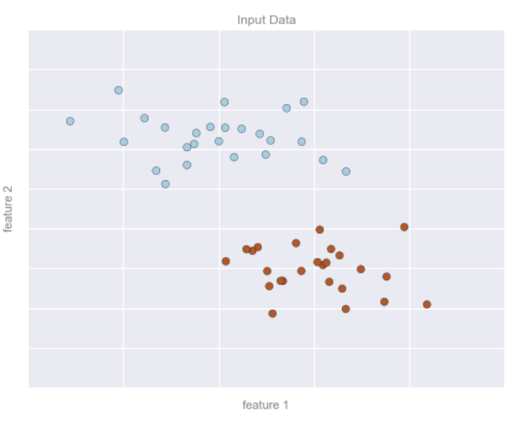
Classification: Predicting discrete labels
A simple data set for classification

Slide 17
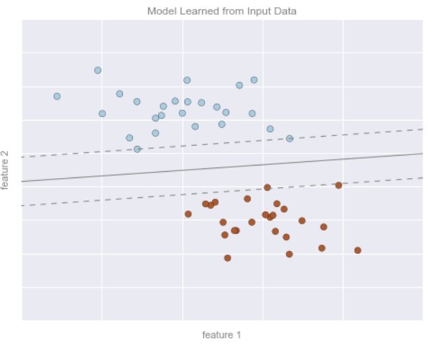
Classification: Predicting discrete labels
A simple classification model

Slide 18
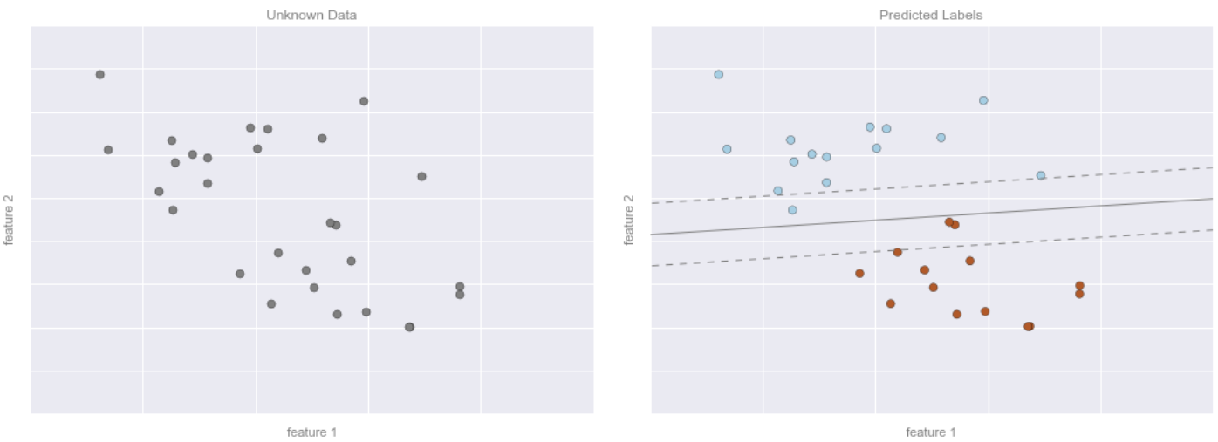
Classification: Predicting discrete labels
Applying a classification model to new data

Slide 19
Classification: Predicting discrete labels
Example of Classification Algorithms
Naive Bayes Classification
Support Vector Machines
Decision Trees and Random Forests
Example of Classification Applications
Automated spam detection for email
Identity Fraud Detection
Image Classification
Diagnostics

Slide 20
Regression

Slide 21
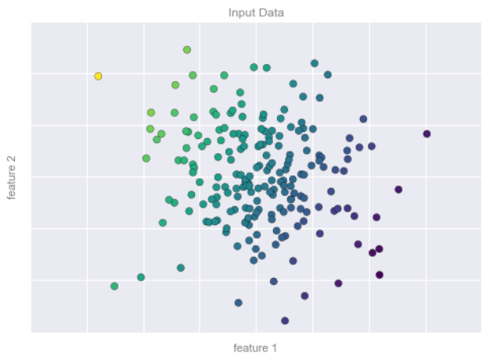
Regression: Predicting continuous labels
A simple dataset for regression

Slide 22
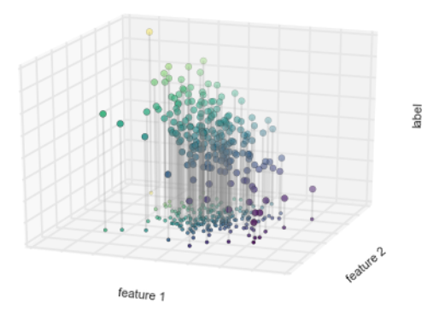
Regression: Predicting continuous labels
A three-dimensional view of the regression data

Slide 23
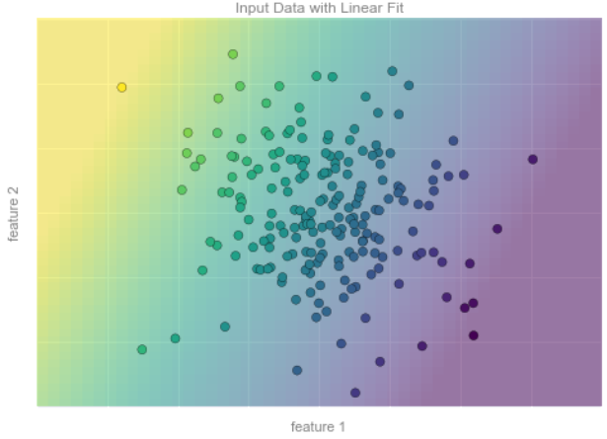
Regression: Predicting continuous labels
A representation of the regression model

Slide 24
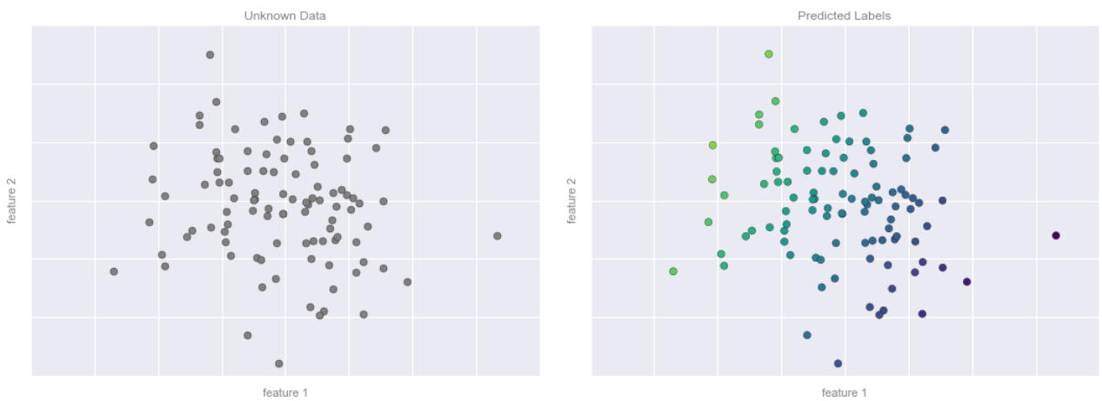
Regression: Predicting continuous labels
Applying the regression model to new data

Slide 25
Regression: Predicting continuous labels
Example of Regression Algorithms
Linear Regression
Support Vector Machines
Decision Trees and Random Forests
Example of Regression Applications
Computing the distance to galaxies observed through a telescope
Population Growth Prediction
Advertising Popularity prediction
Weather Forecasting
Market Forecasting
Notes:
https://www.geeksforgeeks.org/ml-rainfall-prediction-using-linear-regression/

Slide 26
Clustering

Slide 27
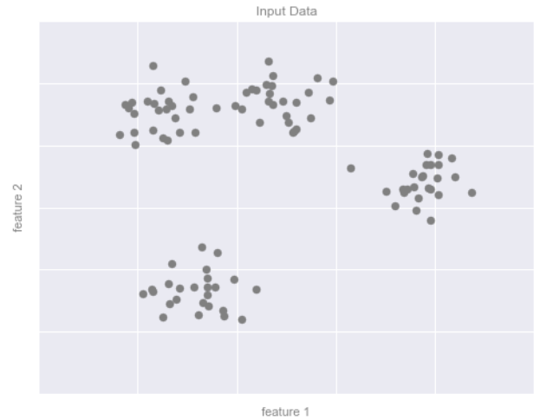
Clustering: Inferring labels on unlabelled data
Example data for clustering

Slide 28
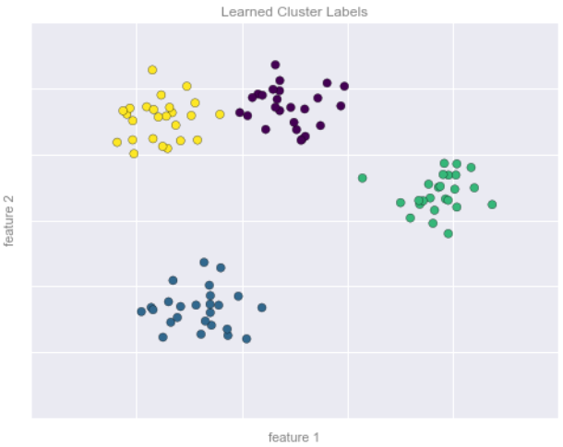
Clustering: Inferring labels on unlabelled data
Data labelled with a k-means clustering model

Slide 29
Clustering: Inferring labels on unlabelled data
Example of Clustering Algorithms
k-Means Clustering
Gaussian Mixture Models
Spectral clustering
Example of Clustering Applications
Recommender Systems
Customer Segmentation
Targeted Marketing

Slide 30
Dimensionality reduction

Slide 31
Dimensionality reduction: Inferring structure of unlabelled data
it seeks to pull out some low-dimensional representation of data that in some way preserves relevant qualities of the full dataset.
One dimensional line that is arranged in a spiral within this two-dimensional space.
A suitable dimensionality reduction model in this case would be sensitive to this nonlinear embedded structure, and be able to pull out this lower-dimensionality representation.
Notes:
เป็นการลดมิติของข้อมูล เป็นกลไกที่ทำให้เราไม่จำเป็นต้องเก็บข้อมูลไว้ครบ แต่ก็ยังสามารถจำแนกข้อมูลได้
ซึ่งนอกจากจะทำให้ง่ายที่จะ visualize แล้ว เมื่อมีมิติที่น้อยลง
นั่นหมายถึงมี feature ที่น้อยลง
ซึ่งทำให้ performance ดีขึ้น และลด space complexity อีกด้วย

Slide 32
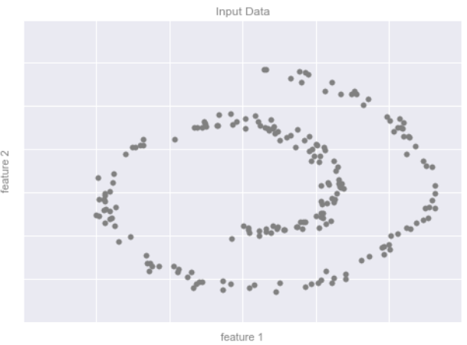
Dimensionality reduction: Inferring structure of unlabelled data
Example data for dimensionality reduction
Notes:
https://www.facebook.com/RProgrammingTH/photos/feature-engineering-dimensionality-reduction-part2%E0%B8%95%E0%B9%88%E0%B8%AD%E0%B8%88%E0%B8%B2%E0%B8%81%E0%B9%82%E0%B8%9E%E0%B8%AA%E0%B8%97%E0%B8%B5%E0%B9%88%E0%B9%81%E0%B8%A5%E0%B9%89%E0%B8%A7%E0%B8%99%E0%B8%B0%E0%B8%84%E0%B8%A3%E0%B8%B1%E0%B8%9A-dimensi/238067543266652/

Slide 33
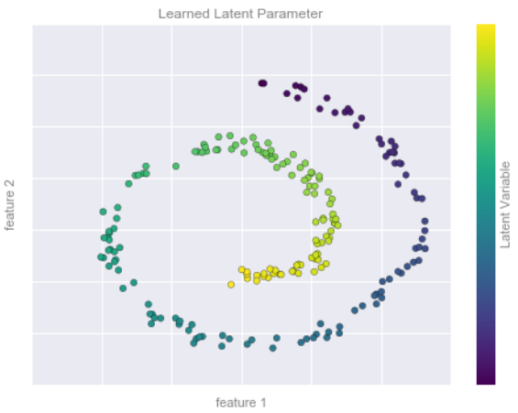
Dimensionality reduction: Inferring structure of unlabelled data
Data with a label learned via dimensionality reduction

Slide 34
Summary: What Is Machine Learning?
Supervised learning
Models that can predict labels based on labelled training data
Classification
Models that predict labels as two or more discrete categories
Regression
Models that predict continuous labels
Unsupervised learning
Models that identify structure in unlabelled data
Clustering
Models that detect and identify distinct groups in the data
Dimensionality reduction
Models that detect and identify lower-dimensional structure in higher dimensional data

Slide 35
Introducing Scikit-Learn
https://scikit-learn.org/

Slide 36
Introducing Scikit-Learn
Scikit-Learn is the best known Python libraries for implementing machine learning algorithms.
Data Representation in Scikit-Learn
Data as table
Features matrix
Target array

Slide 37
Data as table
A basic table is a two-dimensional grid of data
Rows represent individual elements of the dataset
Columns represent quantities related to each of these elements.
For example, consider the Iris dataset, famously analysed by Ronald Fisher in 1936.
We can download this dataset in the form of a Pandas DataFrame using the Seaborn library

Slide 38
Data as table
In[1]: import seaborn as sns
iris = sns.load_dataset('iris’)
iris.head()
 | sepal_length | sepal_width | petal_length | petal_width | species
0 | 5.1 | 3.5 | 1.4 | 0.2 | setosa
1 | 4.9 | 3.0 | 1.4 | 0.2 | setosa
2 | 4.7 | 3.2 | 1.3 | 0.2 | setosa
3 | 4.6 | 3.1 | 1.5 | 0.2 | setosa
4 | 5.0 | 3.6 | 1.4 | 0.2 | setosa
5 samples
Each row of the data refers to a single observed flower.
The number of rows is the total number of flowers in the dataset.
In general, we will refer to the rows of the matrix as samples, and the number of rows as n_samples.
Notes:
import seaborn as sns
iris = sns.load_dataset('iris')
iris.head()

Slide 39
Data as table
In[1]: import seaborn as sns
iris = sns.load_dataset('iris’)
iris.head()
5 features
 | sepal_length | sepal_width | petal_length | petal_width | species
0 | 5.1 | 3.5 | 1.4 | 0.2 | setosa
1 | 4.9 | 3.0 | 1.4 | 0.2 | setosa
2 | 4.7 | 3.2 | 1.3 | 0.2 | setosa
3 | 4.6 | 3.1 | 1.5 | 0.2 | setosa
4 | 5.0 | 3.6 | 1.4 | 0.2 | setosa
Each column of the data refers to a particular quantitative piece of information that describes each sample.
In general, we will refer to the columns of the matrix as features, and the number of columns as n_features.
Notes:
import seaborn as sns
iris = sns.load_dataset('iris')
iris.head()

Slide 40
Features matrix
This table layout makes clear that the information can be thought of as a two dimensional numerical array or matrix, which we will call the features matrix.
This features matrix is often stored in a variable named X.
The features matrix is assumed to be two-dimensional, with shape [n_samples, n_features]
The samples (i.e., rows) always refer to the individual objects described by the dataset.
The features (i.e., columns) always refer to the distinct observations that describe each sample in a quantitative manner.

Slide 41
Target array
In addition to the feature matrix X, we also generally work with a label or target array, which by convention we will usually call y.
The target array is usually one dimensional, with length n_samples.
For example, in the preceding data we may wish to construct a model that can predict the species of flower based on the other measurements.
In this case, the species column would be considered the target feature.

Slide 42
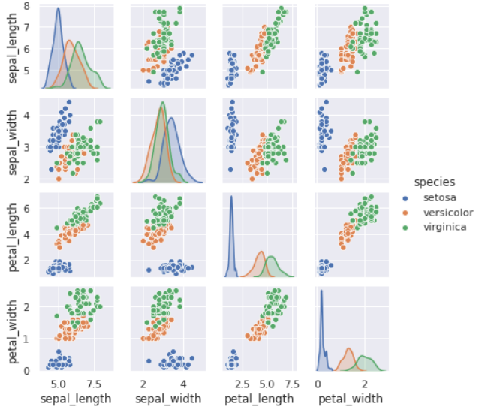
Target array
In[2]: %matplotlib inline
import seaborn as sns; sns.set()
sns.pairplot(iris, hue='species', size=1.5);
A visualization of the Iris dataset
Notes:
hue กำหนดให้ feature ที่ชื่อ species แสดงสีที่แตกต่างกัน

Slide 43
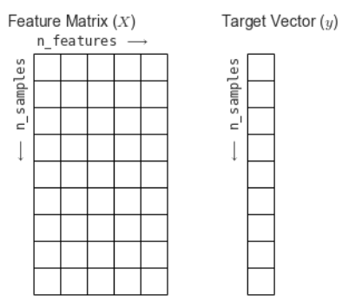
Target array
For use in Scikit-Learn, we will extract the features matrix and target array from the DataFrame.
In[3]: X_iris = iris.drop('species', axis=1)
X_iris.shape
Out[3]: (150, 4)
In[4]: y_iris = iris['species']
y_iris.shape
Out[4]: (150,)

Slide 44
Scikit-Learn’s Estimator API
Most commonly, the steps in using the Scikit-Learn estimator API are as follows
Choose a class of model by importing the appropriate estimator class from ScikitLearn.
Choose model hyperparameters by instantiating this class with desired values.
Arrange data into a features matrix and target vector.
Fit the model to your data by calling the fit() method of the model instance.
Apply the model to new data:
For supervised learning, often we predict labels for unknown data using the predict() method.
For unsupervised learning, we often transform or infer properties of the data using the transform() or predict() method.

Slide 45
HandsOn-01
Simple Linear Regression

Slide 46
HandsOn-02
Iris Classification and Dimensionality

Slide 47
HandsOn-03Rainfall Prediction
Rainfall Prediction using Linear Regression

Slide 48
Summary
The steps in using the Scikit-Learn estimator API
Choose a class of model
Choose model hyperparameters
Arrange data into a features matrix and target vector (supervised).
Fit the model to the training data
Use the model to predict labels for new data

Slide 49
Hyperparameters and Model Validation

Slide 50
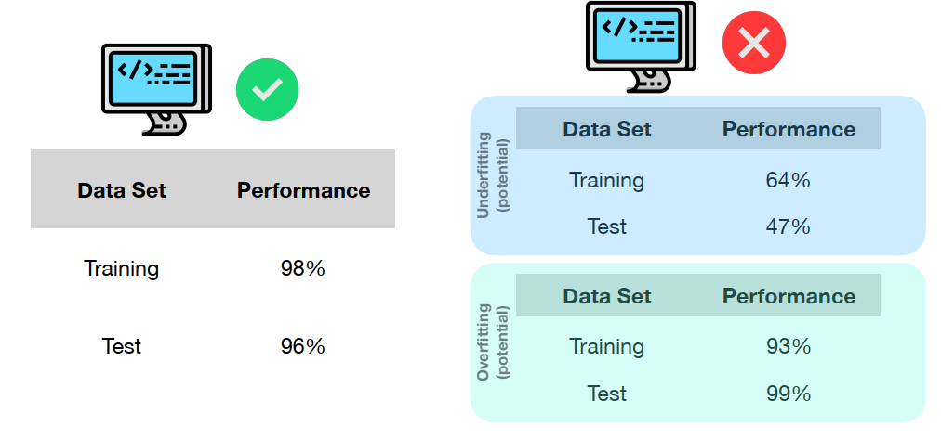
Hyperparameters and Model Validation
Model Validation is a way to validate that our model and our hyperparameters are a good fit to the data.

Slide 51
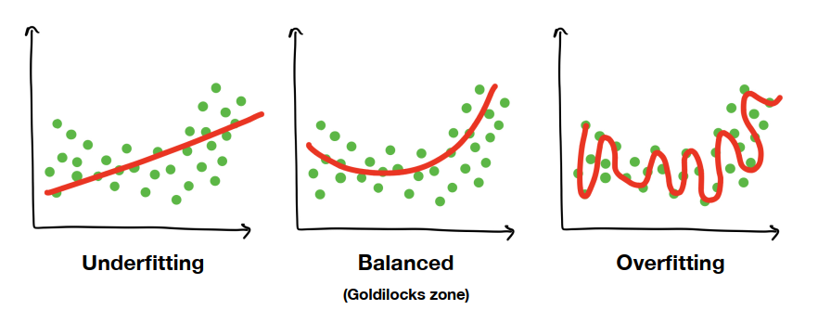
Hyperparameters and Model Validation
Notes:
Underfitting
เปลี่ยน model ให้ advanced ขึ้น
ปรับเปลี่ยน hyperparameters
ลดจำนวน features
ใช้เวลาในการ train ให้นานขึ้น
Overfitting
เพิ่มข้อมูล
ลดความซับซ้อนของ model

Slide 52
HandsOn-04
Model Validation Iris Data (Intro)

Slide 53
Model validation
Holdout
Cross-validation

Slide 54
Model validation
Holdout

Slide 55
Model validation the right way: Holdout sets
We hold back some subset of the data from the training of the model.
Then use this holdout set to check the model performance.
We can do this splitting using the train_test_split utility in Scikit-Learn

Slide 56
HandsOn-04
Model Validation Iris Data (Holdout)

Slide 57
Model validation
Cross-validation

Slide 58
Model validation via cross-validation
One disadvantage of using a holdout set for model validation is that we have lost a portion of our data to the model training.
In the previous case, half the dataset does not contribute to the training of the model!
This is not optimal, and can cause problem especially if the initial set of training data is small.

Slide 59
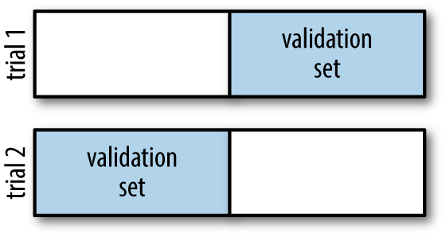
Model validation via cross-validation
One way to address this is to use cross-validation—that is, to do a sequence of fits where each subset of the data is used both as a training set and as a validation set.
Visually, it might look something like

Slide 60
Model validation via cross-validation
In[6]: y2_model = model.fit(X1, y1).predict(X2)
y1_model = model.fit(X2, y2).predict(X1)
accuracy_score(y1, y1_model), accuracy_score(y2, y2_model)
Out[6]: (0.95999999999999996, 0.90666666666666662)
This particular form of cross-validation is a two-fold cross-validation—one in which we have split the data into two sets and used each in turn as a validation set.

Slide 61
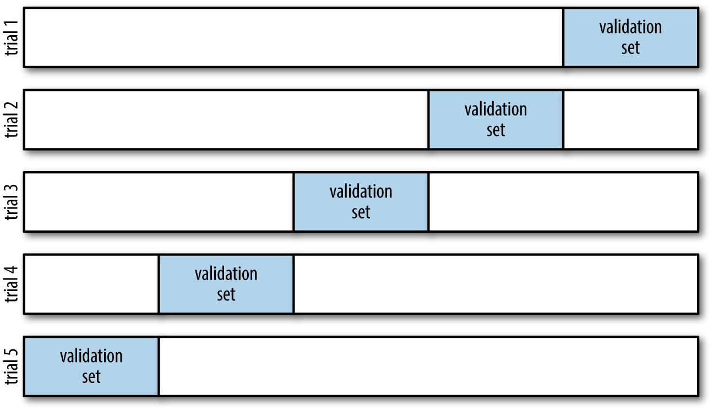
Model validation via cross-validation
five-fold cross-validation

Slide 62

Model validation via cross-validation
five-fold cross-validation

Slide 63
HandsOn-04
Model Validation Iris Data (Cross-validation)

Slide 64
Selecting the Best Model

Slide 65
Selecting the Best Model
Of core importance is the following question: if our estimator is underperforming, how should we move forward?
There are several possible answers.
Use a more complicated/more flexible model
Use a less complicated/less flexible model
Gather more training samples
Gather more data to add features to each sample
Notes:
counterintuitive ขัดต่อความรู้สึก ขัดต่อ common sense ของคนทั่วไป

Slide 66
Selecting the Best Model
Notes:
Underfitting
เปลี่ยน model ให้ advanced ขึ้น
ปรับเปลี่ยน hyperparameters
ลดจำนวน features
ใช้เวลาในการ train ให้นานขึ้น
Overfitting
เพิ่มข้อมูล
ลดความซับซ้อนของ model

Slide 67
Selecting the Best Model
Sometimes
Using a more complicated model will give worse results.
Adding more training samples may not improve your results.
The ability to determine what steps will improve your model is what separates the successful machine learning practitioners from the unsuccessful.
Notes:
counterintuitive ขัดต่อความรู้สึก ขัดต่อ common sense ของคนทั่วไป

Slide 68
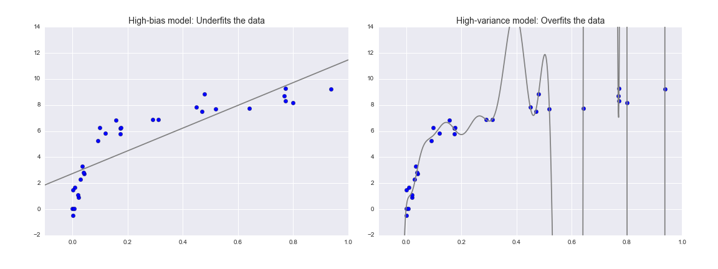
The bias–variance trade-off
Fundamentally, the question of “the best model” is about finding a sweet spot in the trade-off between bias and variance.
A high-bias and high-variance regression model
Notes:
https://medium.com/@kasidissatangmongkol/%E0%B8%81%E0%B8%B2%E0%B8%A3%E0%B9%81%E0%B8%A5%E0%B8%81%E0%B9%80%E0%B8%9B%E0%B8%A5%E0%B8%B5%E0%B9%88%E0%B8%A2%E0%B8%99-errors-%E0%B9%83%E0%B8%99%E0%B9%82%E0%B8%A5%E0%B8%81%E0%B8%82%E0%B8%AD%E0%B8%87-machine-learning-6260933dc6b6

Slide 69
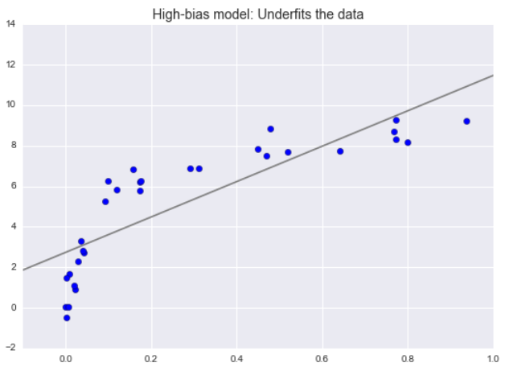
The bias–variance trade-off
The model attempts to find a straight-line fit through the data.
The data are intrinsically more complicated than a straight line, the straight-line model will never be able to describe this dataset well.
Such a model is said to underfit the data; that is, it does not have enough model flexibility to suitably account for all the features in the data.
Another way of saying this is that the model has high bias.

Slide 70
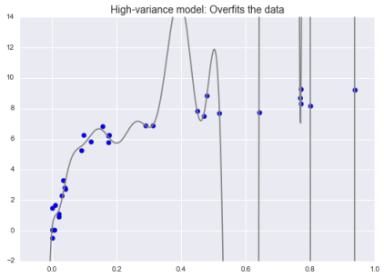
The bias–variance trade-off
The model attempts to fit a high-order polynomial through the data.
Even though it very accurately describes the training data, its precise form seems to be more reflective of the particular noise properties of the data rather than the intrinsic properties of whatever process generated that data.
Such a model is said to overfit the data; that is, it has so much model flexibility that the model ends up accounting for random errors as well as the underlying data distribution.
Another way of saying this is that
the model has high variance.

Slide 71
Validation Curves

Slide 72
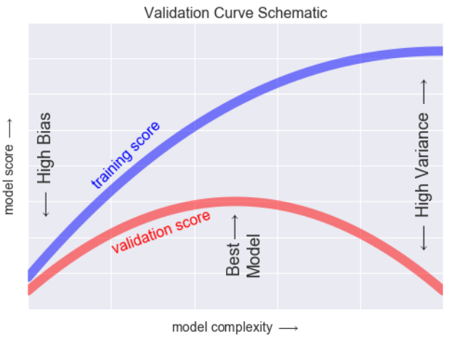
Validation Curves

Slide 73
Validation Curves
The training score is everywhere higher than the validation score. This is generally the case: the model will be a better fit to data it has seen than to data it has not seen.
For very low model complexity (a high-bias model), the training data is underfit, which means that the model is a poor predictor both for the training data and for any previously unseen data.
For very high model complexity (a high-variance model), the training data is overfit, which means that the model predicts the training data very well, but fails for any previously unseen data.
For some intermediate value, the validation curve has a maximum. This level of complexity indicates a suitable trade-off between bias and variance.

Slide 74
Validation curves in Scikit-Learn
We will use a polynomial regression model: this is a generalized linear model in which the degree of the polynomial is a tuneable parameter.
For example,
A degree-1 polynomial fits a straight line to the data; for model parameters a and b:
y = ax + b
A degree-3 polynomial fits a cubic curve to the data; for model parameters a, b, c, d:
y = ax³ + bx² + cx + d

Slide 75
HandsOn-05
Validation Curves using Polynomial Regression (Validation Curves)

Slide 76
Learning Curves
Notes:
อัตราความก้าวหน้า หรือความเร็ว-ความช้าในการเรียนรู้ทักษะใหม่

Slide 77
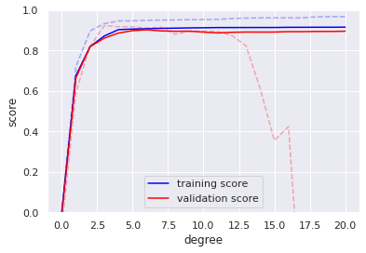
Learning Curves
One important aspect of model complexity is that the optimal model will generally depend on the size of your training data.
6

Slide 78
Learning Curves
The behaviour of the validation curve has two important inputs:
the model complexity
the number of training points
A plot of the training/validation score with respect to the size of the training set is known as a learning curve.
Notes:
Learning curve ทำได้โดยการ plot Jₜᵣₐᵢₙ(θ), Jᵥ(θ) เทียบกับจำนวน training example เพื่อดูว่า model ของเรากำลังมีปัญหา bias หรือ variance

Slide 79
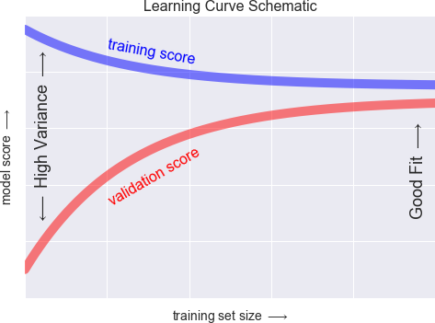
Learning Curves

Slide 80
Learning Curves
The general behavior we would expect from a learning curve is this:
A model of a given complexity will overfit a small dataset: this means the training score will be relatively high, while the validation score will be relatively low.
A model of a given complexity will underfit a large dataset: this means that the training score will decrease, but the validation score will increase.
A model will never, except by chance, give a better score to the validation set than the training set: this means the curves should keep getting closer together but never cross.

Slide 81
HandsOn-05
Validation and Learning Curves
(Learning Curves)

Slide 82
Validation in Practice: Grid Search
Grid search is the process of performing hyper parameter tuning in order to determine the optimal values for a given model.
Here is an example of using grid search to find the optimal polynomial model.
In[18]: from sklearn. model_selection import GridSearchCV
param_grid = {'polynomialfeatures__degree': np.arange(21),
'linearregression__fit_intercept': [True, False],
'linearregression__normalize': [True, False]}
grid = GridSearchCV(PolynomialRegression(), param_grid, cv=7)
Notes:
การทำ grid search เพื่อค้นหา best parameters
งานวิจัยของ Bergstra และ Bengio ชื่อว่า Random Search for Hyper-Parameter Optimization สรุปว่า random search ให้ประสิทธิภาพที่ดีกว่า grid search

Slide 83
Validation in Practice: Grid Search
Calling the fit() method will fit the model at each grid point
In[19]: grid.fit(X, y)
Display the best parameters
In[20]: grid.best_params_
Out[20]: {'linearregression__fit_intercept': False,
'linearregression__normalize': True,
'polynomialfeatures__degree': 4}

Slide 84
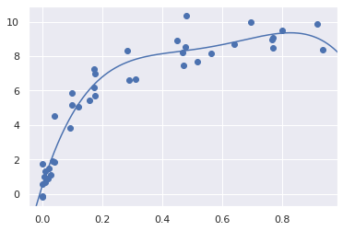
Validation in Practice: Grid Search
Use the best model and show the fit to our data
In[21]: model = grid.best_estimator_
plt.scatter(X.ravel(), y)
lim = plt.axis()
y_test = model.fit(X, y).predict(X_test)
plt.plot(X_test.ravel(), y_test);
plt.axis(lim);

Slide 85
HandsOn-05
Validation and Learning Curves
(GridSearchCV)

Slide 86
HandsOn-06
Social Adv with Decision Tree
(Assignment)

